Slide 1
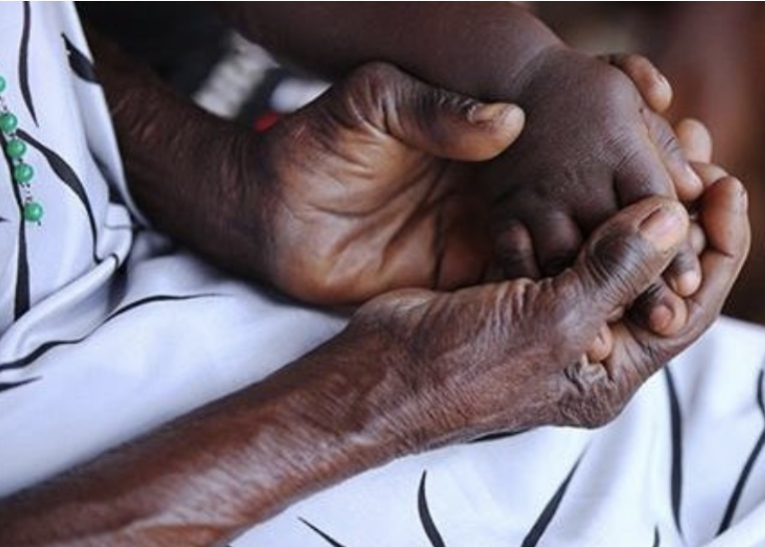
Royal City Gogos
Hand in Hand with African
Grandmothers
2009 - 2023

Slide 2
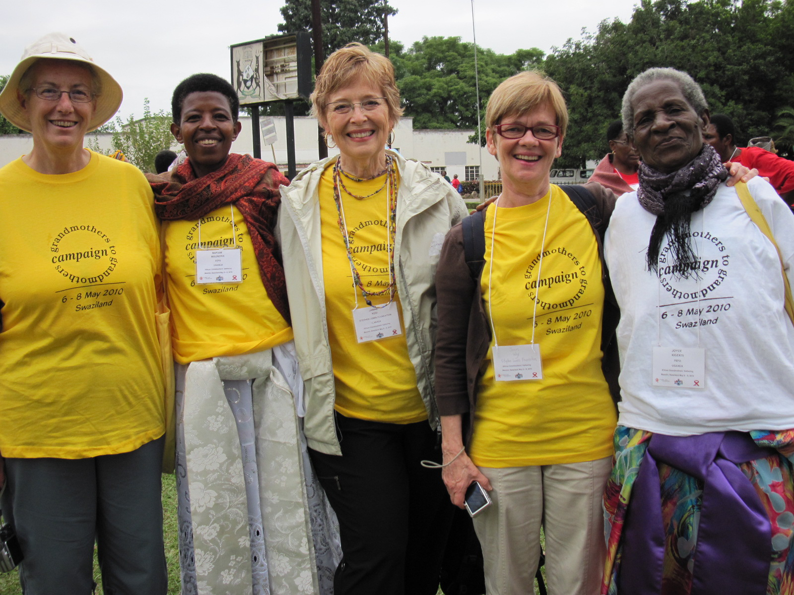

Slide 3
AIDS statistics – UNAIDS.org
Approximately 30 million people have died of AIDS in sub Saharan Africa.
37.7 million people globally were living with HIV in 2020 and sub-Saharan Africa is home to 67% of them
4200 adolescent girls and young women between 15 – 24 acquire HIV every week
In 2020, women and girls accounted for 63% of new HIV infections
Covid lockdowns have disrupted HIV testing and could result in up to 300,000 additional HIV infections

Slide 4
Why was AIDS able to become, and continues to be, a pandemic in Africa?

Slide 5
Some contributing factors are:
The Slave trade
Colonialism
Apartheid
Brain drain
Corruption
Lack of Education
Gender inequality
Malaria, Polio, TB, Ebola
Russo – Ukraine War affects food supplies
Climate change
Most information from “The Betrayal of Africa” by Gerald Kaplan, UNAIDS, SLF website
Notes:
Some of these factors are centuries old but continue to shape the conditions for the population. Others are recent and on-going factors.

Slide 6
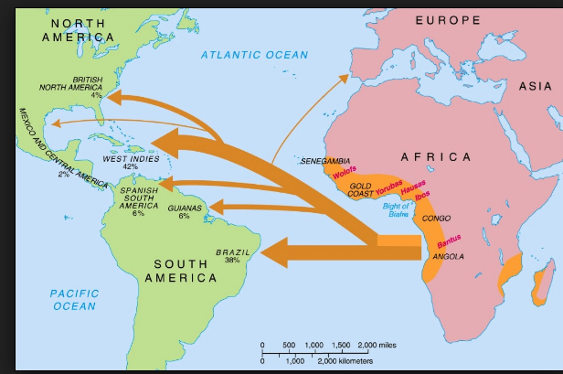
Slave trade:
30 – 60 million people were taken into slavery.
Notes:
If you think that slavery is old news and should not be a factor in modern day, just consider the residual effects of slavery in America.

Slide 7
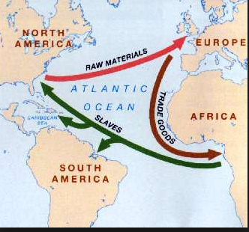
Effects of slavery on African nations
As workers needed for agriculture and industry were taken as slaves, famine and death occur in Africa.
A work force that would have contributed to an agrarian revolution, and subsequent industrial revolution in Africa, was enslaved
Cultures were destroyed.
Subsequently, societies were weakened and not able to resist colonialism.

Slide 8
Colonialism– 15th Century – 1960s
Colonialism is defined as the exploitation of a weak country’s resources to strengthen and enrich the stronger country.
Europeans weakened and underdeveloped Africa by sucking out human and natural resources.

Slide 9
Effects of colonialism
The Conference of Berlin in 1884 partitioned the continent in ways convenient to Europeans.
It created unnatural divisions between “countries” with little regard for the historical ways of the people, the climate, access to water, energy sources, or the viability of countries to sustain the population.
The partitions created countries that have been historically plagued by drought and famine.
Notes:
This is similar to First Nations who considered their traditional lands to straddle both Canada and the US. Are they “Canadian” or

Slide 10
Effects of colonialism
Unnatural “country” divisions created no loyalty to the new nation and caused people to revert to their ethnic background for identity.
Colonial masters used a “Divide and Rule” strategy to pit ethnic groups against each other.
This created a heritage of warring and death.
The Rwandan genocide, in which approximately 1 million people were killed in less than 100 days, is one example of this.
Notes:
Rape was used as a weapon of war in Rwanda and caused a spike in HIV infections.

Slide 11
Effects of colonialism
The partition of Africa created 15 landlocked countries.
Because so many countries do not have port facilities, goods have to be transported long distances over thousands of miles of bad roads.
Truckers may be away from home for months.
They may frequent overnight truck stops with strip clubs, brothels, and adult book stores.

Slide 12
Effects of colonialism:
The spread of AIDS can be mapped in “hot spots” along the highway systems of Africa.
This map is an example.
Young girls often frequent the truck stops to get money to feed their families.

Slide 13
Effects of colonialism:
In the 1960s as independence from colonial masters was about to occur:
death rates for African children were the highest in the world
life expectancy in African countries was the lowest in the world
16% were illiterate
in all sub Saharan countries there were only 8000 secondary school graduations per 200 million people.
France did not build a single university.
Portugal burned all their infrastructure upon departure.

Slide 14
Legacy of colonialism
African countries were so impoverished by colonialism they had few resources to combat HIV/AIDS

Slide 15
AIDS and Gender Inequality
Women are especially vulnerable.

Slide 16
AIDS and Gender Inequality
Some women are purchased with a bride price and become chattel. They have little or no control over their personal security, their health, their finances or their sexual autonomy.

Slide 17
Meet Philly. Part 1

Slide 18
Context for the formation of the Stephen Lewis Foundation

Slide 19
Who is Stephen Lewis?
Former UN Ambassador
Former Special Envoy for AIDS in Africa
Renowned Canadian humanitarian
His daughter Ilana Landsberg-Lewis was a human rights lawyer with the UN.
Chair of the SLF board

Slide 20
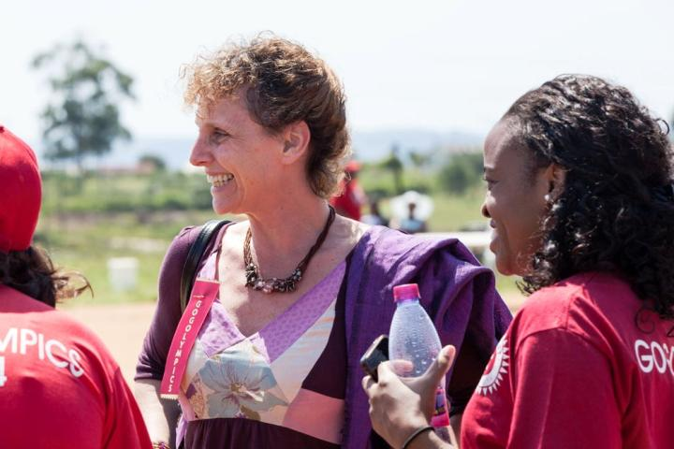
The Stephen Lewis Foundation was founded in 2003 by Stephen Lewis and Ilana Landsberg-Lewis. The goal of the SLF was to Ease the Pain of AIDS in Africa.

Slide 21
AIDS in Africa
Sub Saharan Africa alone accounts for an estimated 53% or all people living with HIV

Slide 22
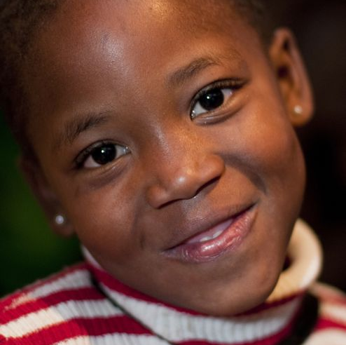
Many children, especially girls, are withdrawn from school to work or care for their sick parents and grandparents.

Slide 23
13.3 million children are orphans *SLF fact sheet
That’s almost twice the number of children in Canada.

Slide 24
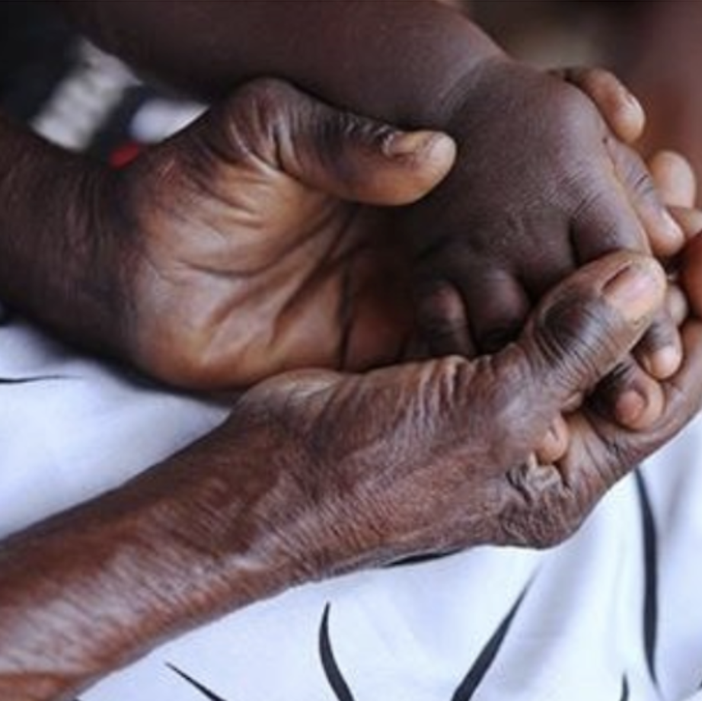
Children may care for the dying through a prolonged and agonizing decline. .

Slide 25
As adults continue to die of AIDS, the children are left behind – deprived of parental guidance – vulnerable, bereaved, and lacking access to education.
Notes:
Change undereducated

Slide 26
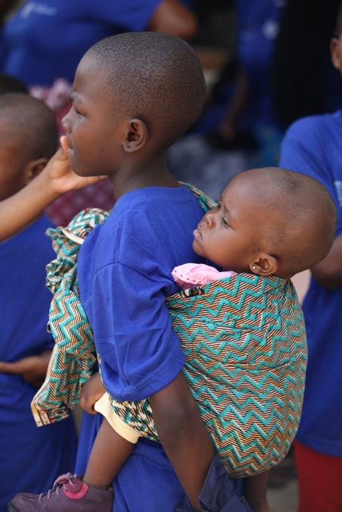
Children raising children
Approximately
7 million children live in child-headed households with no adult to care for them.

Slide 27
In 2003 when the SLF first was founded these were the priorities:
Women
Orphans and Vulnerable Children
Home-based care
Gender violence
Positive living

Slide 28
At first, grandmothers were not identified as a focus for the SLF.
But the Community-based organizations began to ask for funding for “caregivers.”
These caregivers were grandmothers.

Slide 29
Grandmothers had lost their beloved sons and daughters to HIV/AIDS, facing a grief beyond comprehension.
Notes:
Photo: Eric O’Donnell
Who is in this picture? (grandmothers and children) Who is missing? Where are the daughters and the sons? A whole missing generation, grieved by grandmothers and children alike.
Use this slide or a story from your heart to connect emotionally with your audience. Imagine if this was your family –This is a very graphic representation of the situation at the grassroots in sub Saharan Africa. Take time to connect well.
Tell why you’re involved -- What inspires you? Ask the audience if any have been to Africa

Slide 30
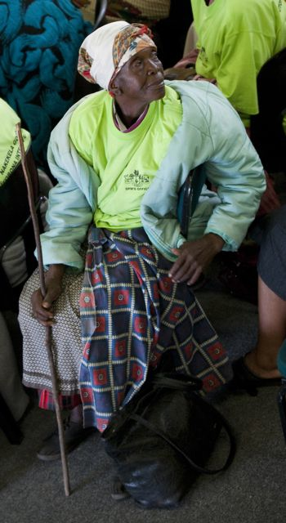
Grandmothers were often elderly and infirm. Along with losing their children, they may also have lost their income security, and in many cases, their homes.

Slide 31
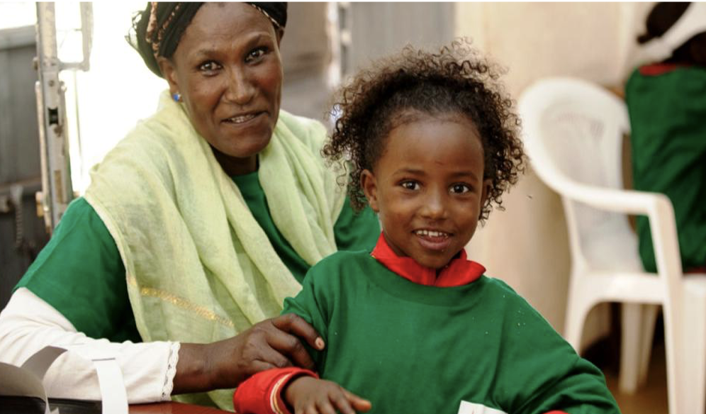
Yet grandmothers rose beyond their grief and begin to parent again, raising their own grandchildren and other orphans who are abandoned.

Slide 32
Toronto 2006
The Stephen Lewis Foundation brought African and Canadian grandmothers together to share their stories.

Slide 33
Canadian grandmothers were moved by their stories and vowed, “We will not rest until they can rest.”

Slide 34
African grandmothers vowed, “We will not raise children for the grave.” *Toronto Statement

Slide 35
The Grandmothers to Grandmothers Campaign was launched, 2006

Slide 36
Our mandate is…

Slide 37
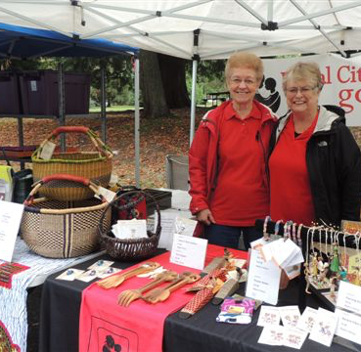
To raise funds
Since 2006, the Grandmothers Campaign has raised over $40 million.

Slide 38
To Raise Awareness

Slide 39
To build solidarity
Notes:
Solidarity with Canadian women deepens.

Slide 40
The Grandmothers Campaign has approx. 150 active groups in
Canada
UK
Australia

Slide 41
In Lower Mainland we call ourselves “gogos”
Gogo is a Zulu word for grandmother.
We write it Gogo or gogo.
We are not
Go-Gos.
We are not “gogo grannies” or “grannies-a-Go-Go.”
PLEASE.

Slide 42
Other groups have their own unique names. For example:
Victoria Grandmothers for Africa
Hamilton Grandmothers of Steel
Calgary Ujamma Grammas
Edmonton G.A.N.G.

Slide 43
How the SLF works with community-led partners…( “CBOs”- Community-based organizations)

Slide 44
The SLF believes the expertise needed to turn the tide of AIDS is found within Africa at the community level
Due diligence is done before and throughout funding

Slide 45
How the SLF, using anti-colonial practices, approaches partnerships
Bottom-up decision-making
Long-term relationships
Empower not Restrict
Support not Demand
Encourage not Dictate
Connect not Compete
Champion not Lead

Slide 46
The goal of the CBOs is to foster resilience.
Resilience is defined as “people’s ability to cope with crises, to regroup and rebuild and to continue on with their lives.”

Slide 47
The first step to resilience is grief counseling.
Grief counseling releases a flood of emotions.

Slide 48
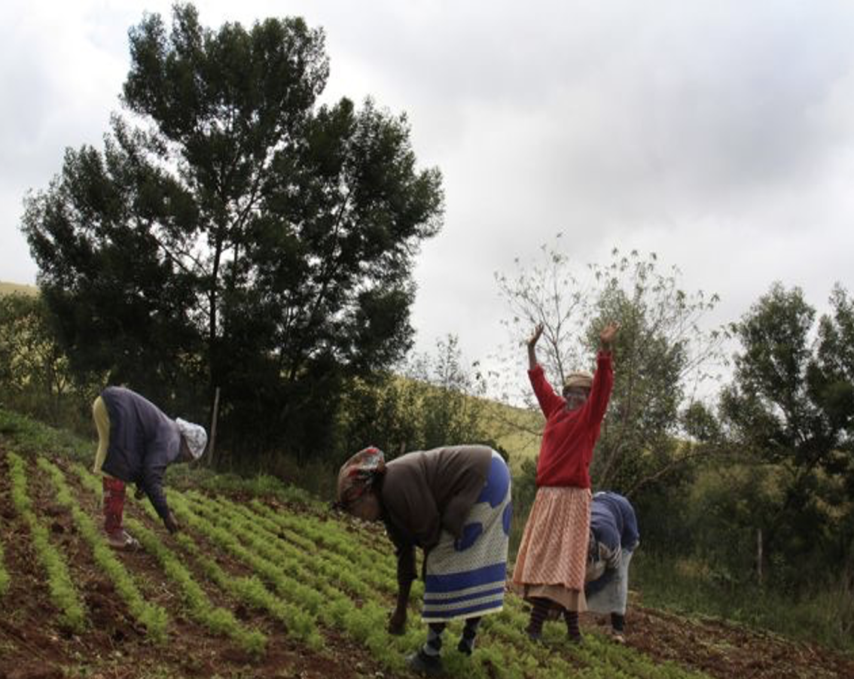
Gardens grow and basic needs are met

Slide 49
With basic needs met, the CBOs respond to different needs:
An end to violence against grandmothers.
Meaningful support in the form of pensions and social security.
End of property grabbing and wife inheritance.

Slide 50
With sustained funding, the work of regrouping and rebuilding begins…
Development of income and savings programs
Grandparents learn to parent again
People join together in mutual support groups
Children begin to play and create
There is a restored feeling of personal and family security
There is renewed power to plan for the future
There is renewed capacity to experience happiness and the pleasures of daily life.

Slide 51
Finally, grandmothers take action toward self-determination…
People take leadership roles in tackling challenges faced by communities.
Children stay on ARV treatment, graduate from high school, start to earn decent livings.
Grandmothers join local councils to start campaigns against wife inheritance, win legal battles to own the land and demand protection for their rights.

Slide 52
Anti-colonial practice in action: Amplify the voices of grandmothers
CBOs train lobbyists to advocate for human rights for grandmothers and children in their care
They serve on national child-protection and land-rights councils and meet with government officials to demand more equitable policies

Slide 53
As the path to resilience progresses, lives are rebuilt. Hope is restored.

Slide 54
Philly’s story Part 2

Slide 55
SLF Impact
From July 2021 to June 2022, SLF raised $9.4 million
In support of 122 community-led organizations
Working in 15 countries
Bringing the total of funds raised in support of grassroots partners since 2003 to $183 million

Slide 56
Areas of work and impact from July 2021 to June 2022 – how RCG contributed to change…

Slide 57
1. Children and young people
38,000+ children and young people were reached through peer support groups by 57 partners

Slide 58
2. Positive Living
260,000 people received HIV counselling and testing
76% adherence to HIV medication reported by SLF partners while mitigating the impact of COVID 19

Slide 59
3. Ending Violence Against Women and Girls
1100 women and children were supported by 19 SLF partners to escape violence and access shelter

Slide 60
4. Home-based care
100,000+ clients were reached through home-based care

Slide 61
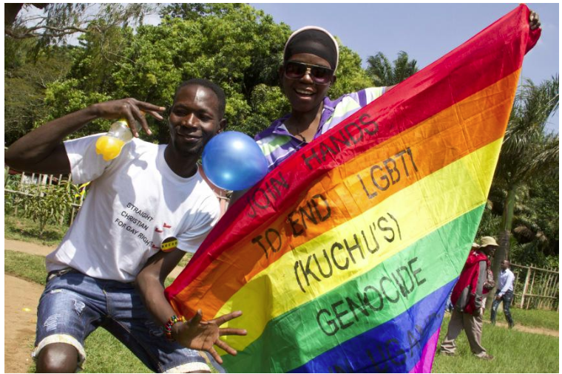
5. Health and Human Rights for LGBTIQ Communities
40,000 people were reached by 15 LGBTIQ organizations with vital care and support.

Slide 62
6. Grandmothers
50,000+ grandmothers participated in support groups and income generation training
200 homes were rebuilt or improved, including 100+ for grandmother-headed households
Notes:
Photo: Alexis MacDonald
We’ll talk more about Grandmothers later

Slide 63
RCG Impact
In 2022, RCG sent $44,615 to the SLF PLUS approximately $15K for Solidarity Cycle, PLUS $5K for Walk New West = approximately $64,615
This is life-changing money. It puts us among the top grandmother donor groups internationally.
Our total since 2009 is approximately $752K

Slide 64
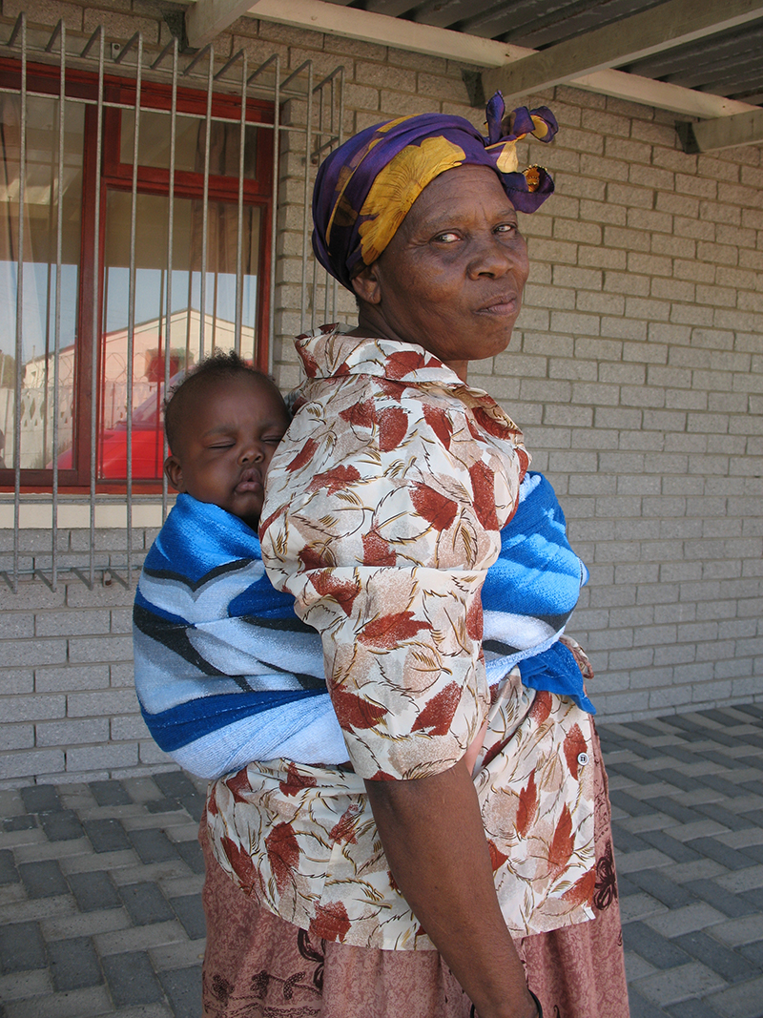
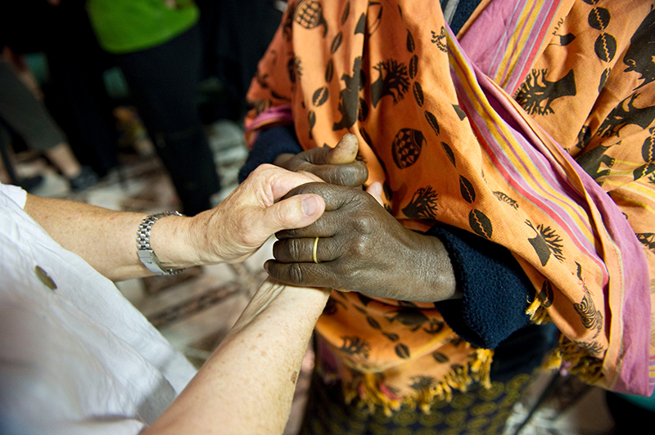
We remember promises made:
African grandmothers vow, “We will not raise another generation for the grave.”
Canadian grandmothers promise, “We will not rest until they can rest.”

Slide 65
Royal City Gogos are grateful for the friendship of our gogo sisters, their willingness to work hard and have fun, their extraordinary talents, and the contributions of our newest members. We look forward to more successful years ahead.

Slide 66
Onward!

